Slide 1
ECE 530 Cloud Computing
Ioannis Papapanagiotou
AWS Infrastructure

Slide 2
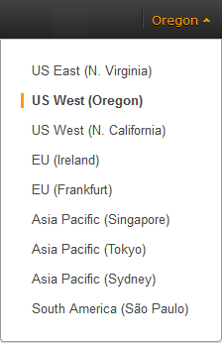
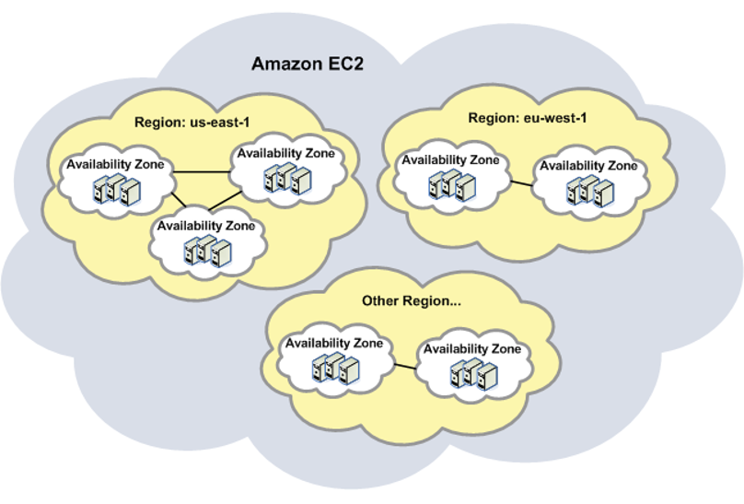
AWS Global Infrastructure
AWS is hosted in multiple locations world-wide. These locations are composed of Regions.
Each region is a separate geographic area.
Each region has multiple, isolated locations known as Availability Zones.
11 Regions
Notes:
When you view your resources, you'll only see the resources tied to the region you've specified. This is because regions are isolated from each other, and we don't replicate resources across regions automatically.
When you work with an instance using the command line interface or API actions, you must specify its regional endpoint.
When you launch an instance, you must select an AMI that's in the same region. If the AMI is in another region, you can copy the AMI to the region you're using.

Slide 3
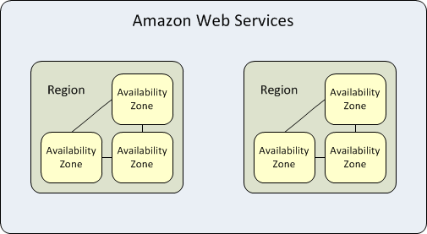
Availability Zones
Each Region has 2 or more "Availability Zones", which are distinct data centers providing AWS services.
Each Amazon EC2 region is designed to be completely isolated from the other Amazon EC2 regions. This achieves the greatest possible fault tolerance and stability.
Several services operate across Availability Zones (e.g., S3, DynamoDB) while others can be configured to replicate across Zones to spread demand and avoid downtime from failures.

Slide 4
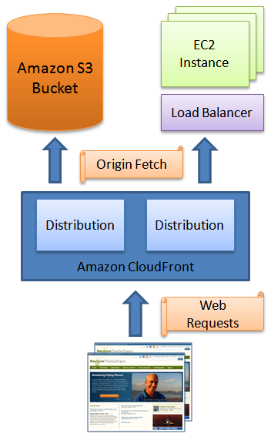
Edge Locations
52 Edge Locations
Edge Locations are CDN edge points
There are many more Edge Locations than Regions.
Used to cache data closed to the user so that the latency is reduced.

Slide 5
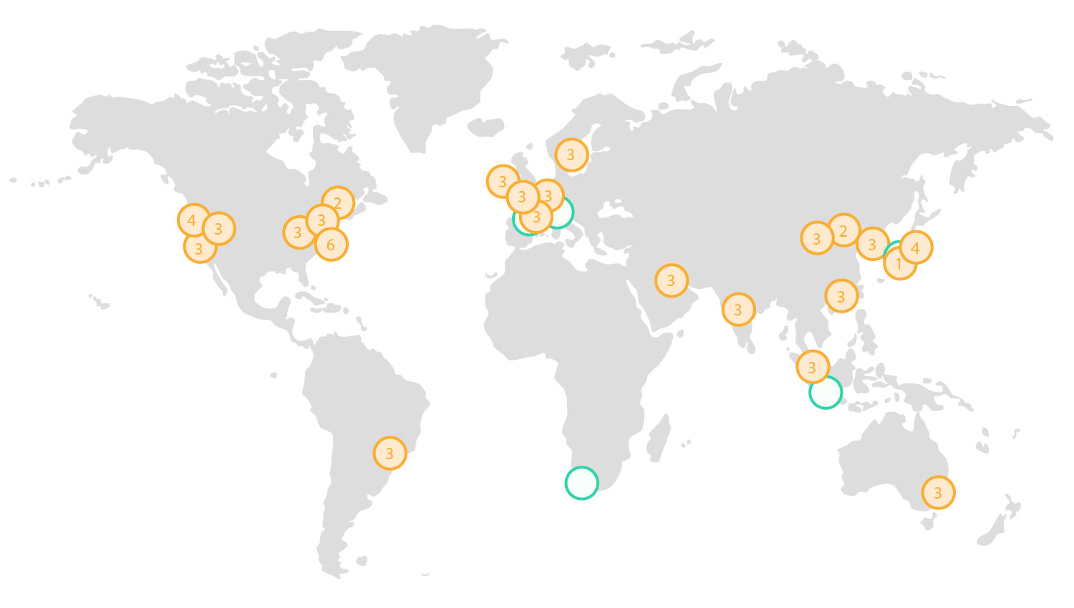
AWS Global Infrastructure
Notes:
The AWS Cloud operates 30 Availability Zones within 11 geographic Regions around the world, with at least 10 more Availability Zones and 5 more Regions coming in 2016.
AWS Regions and Availability Zones
The AWS Cloud infrastructure is built around Regions and Availability Zones (“AZs”). A Region is a physical location in the world where we have multiple Availability Zones. Availability Zones consist of one or more discrete data centers, each with redundant power, networking and connectivity, housed in separate facilities. These Availability Zones offer you the ability to operate production applications and databases which are more highly available, fault tolerant and scalable than would be possible from a single data center. The AWS Cloud operates 30 Availability Zones within 11 geographic Regions around the world.

Slide 6
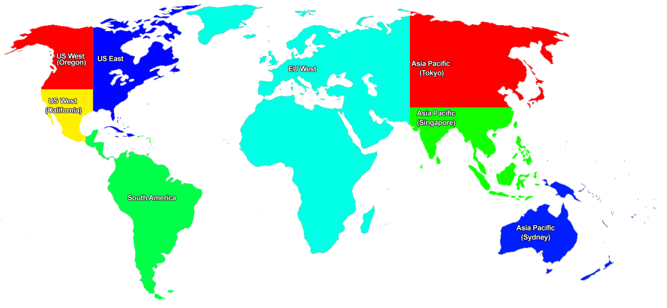
Amazon AWS Map
Code | Name
ap-northeast-1 | Asia Pacific (Tokyo) Region
ap-southeast-1 | Asia Pacific (Singapore) Region
ap-southeast-2 | Asia Pacific (Sydney) Region
eu-west-1 | EU (Ireland) Region
sa-east-1 | South America (Sao Paulo) Region
us-east-1 | US East (Northern Virginia) Region
us-west-1 | US West (Northern California) Region
us-west-2 | US West (Oregon) Region

